Slide 1




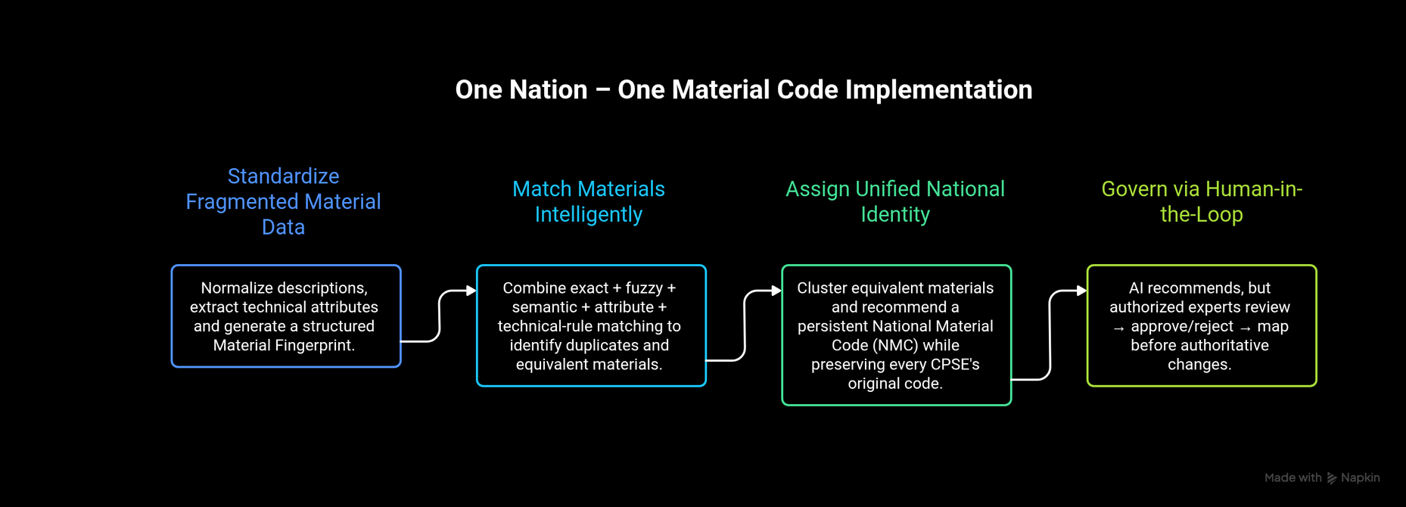
SMART INDIA HACKATHON 2026
TITLE PAGE
  Problem Statement ID – SIH26099
  Problem Statement Title - National Unified Material Master Framework
  Theme - Smart Automation
  PS Category- Software
  Team ID- 140981
  Team Name - SLUG

Slide 2
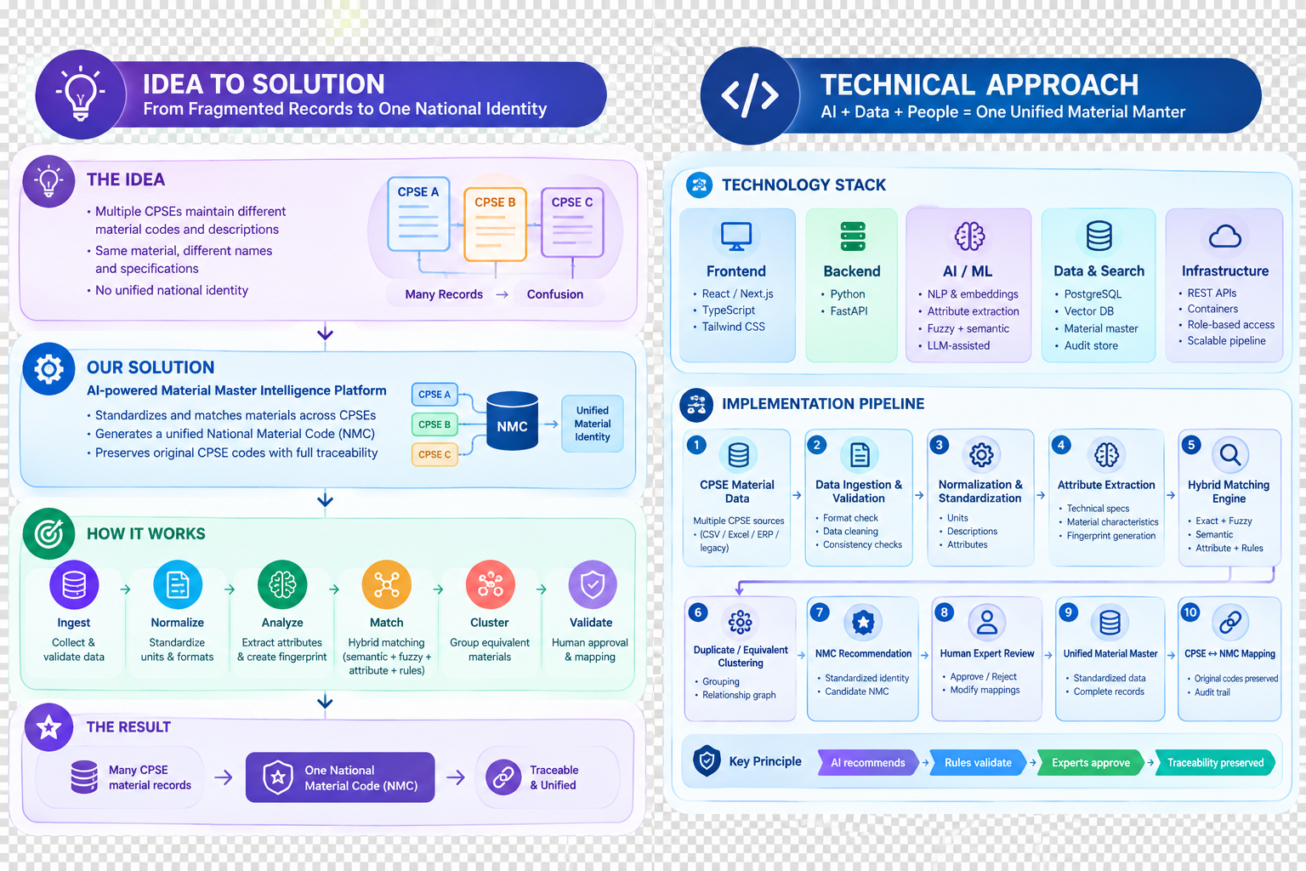
IDEA TITLE
SLUG
PROBLEM:
  Fragmented Material Masters: Different CPSEs use different codes, descriptions, units, specifications, and naming conventions for the same material.
  Duplicate & Near-Duplicate Records: Equivalent materials remain scattered across organizations, creating fragmented procurement information and higher inventory levels.
  Technical Matching Risk: Simple text matching can falsely merge incompatible materials such as SS304 vs SS316 or M16×50 vs M16×100.
  Limited Traceability: Standardization requires preserving legacy codes, source lineage, approval history, and the reasoning behind every AI recommendation.
How It Works
The Result
Ingest
Validate
Collect &
validate data
Human approval
& mapping
Many CPSE
material records
SOLUTION - One Nation, One Material Code:
  From fragmented records to one identity: AI normalizes material data, extracts technical attributes, and generates structured material fingerprints.
  From text similarity to intelligent matching: Hybrid matching combines exact, fuzzy, semantic, attribute, and technical compatibility signals.
  From duplicates to a National Master: Equivalent materials are clustered and mapped to a persistent National Material Code (NMC) while preserving legacy CPSE codes.
  From black-box AI to governed decisions: Every recommendation provides matching evidence, confidence, conflicts, and source lineage for human approval.
Normalize
Cluster
Our Application
Standardize
Units & Formats
Group equivalent
materials
Analyze
Match
Traceable
& Unified
Extract attributes
& create fingerprint
Hybrid matching
One Nation – One Material Code | Standardize. Harmonize. Unify.
2
Notes:
2

Slide 3
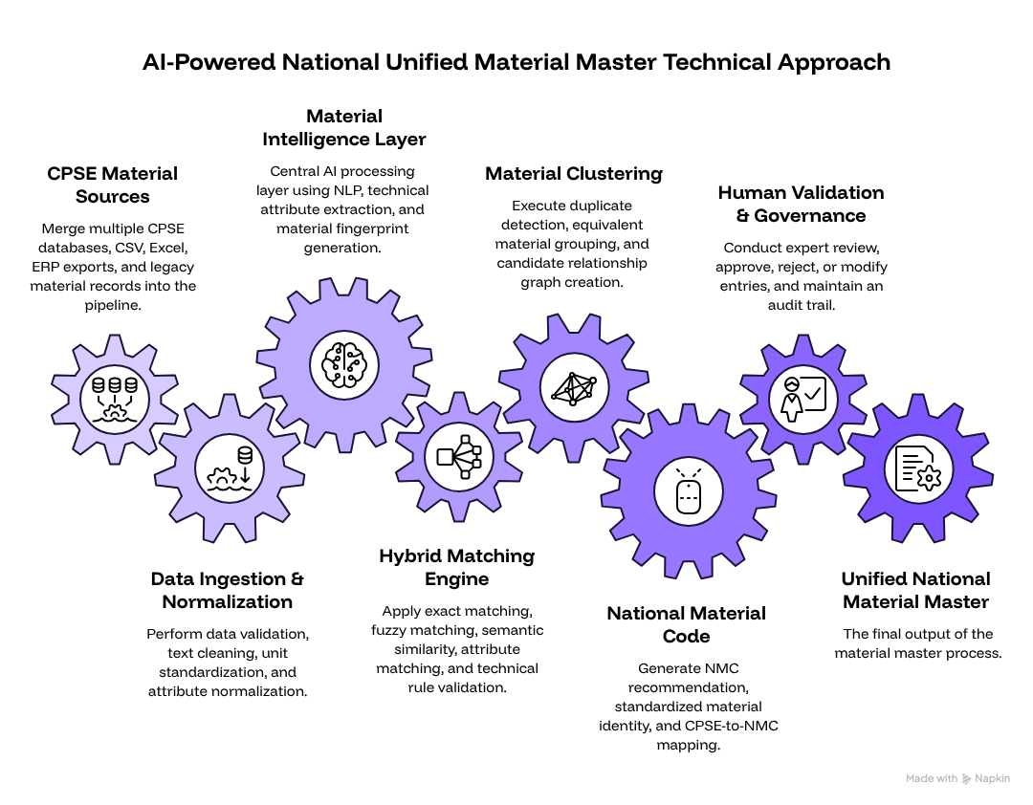
TECHNICAL APPROACH
SLUG
Technology Stack
Frontend: React / Next.js, TypeScript ,
Tailwind CSS
Backend: Python , FastAPI
AI / ML:
  NLP & semantic embeddings
  Entity / attribute extraction
  Fuzzy + semantic similarity
  ML-assisted duplicate detection
  LLM-assisted normalization
Structured material master
Data & Search:
  PostgreSQL
  Vector database / vector search
  Structured material maste
  Structured material master
  Audit & mapping store
  Infrastructure:
  REST APIs
  Containerized deployment
  Role-based access
  Scalable processing pipeline
One Nation – One Material Code | Standardize. Harmonize. Unify.
3
Notes:
3

Slide 4
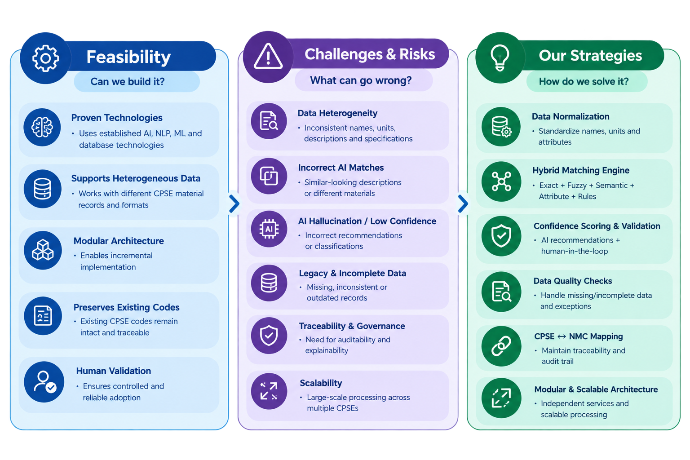
FEASIBILITY AND VIABILITY
SLUG
One Nation – One Material Code | Standardize. Harmonize. Unify.
4
Notes:
4

Slide 5
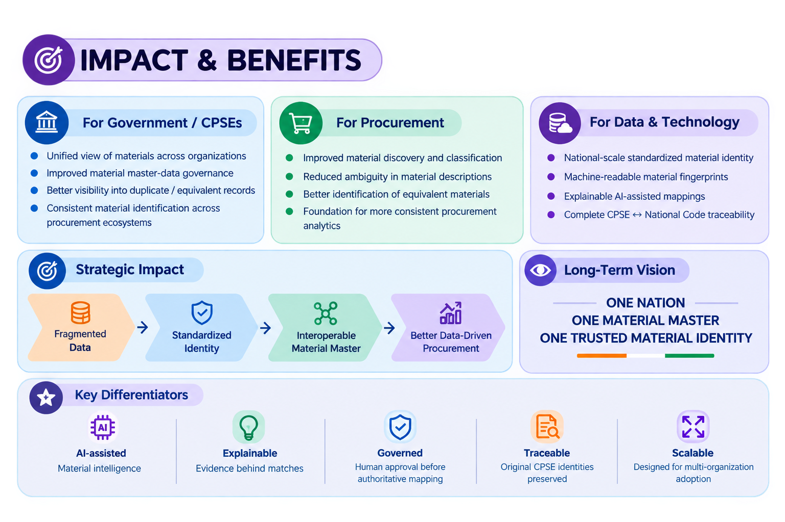
IMPACT AND BENEFITS
SLUG
One Nation – One Material Code | Standardize. Harmonize. Unify.
5
Notes:
5

Slide 6
RESEARCH AND REFERENCES
SLUG
  ISO 8000-110:2021 — Data Quality: Master Data
Supports standardized exchange and semantic representation of master data across organizations.
  ISO 8000-115:2024 — Master Data Quality Identifiers
Relevant to unique identification, semantic resolution and mapping of material identities.
  Reimers & Gurevych (2019) — Sentence-BERT
Foundation for semantic similarity and embe
  W3C PROV — Provenance Data Model
Relevant to maintaining traceability, provenance and audit history of standardized material mappings.
  ISO/TS 8000-82:2022 — Data Quality Rules
Supports the use of machine-processable data rules for maintaining data integrity and reliability.
One Nation – One Material Code | Standardize. Harmonize. Unify.
6
Notes:
6

